Slide 1
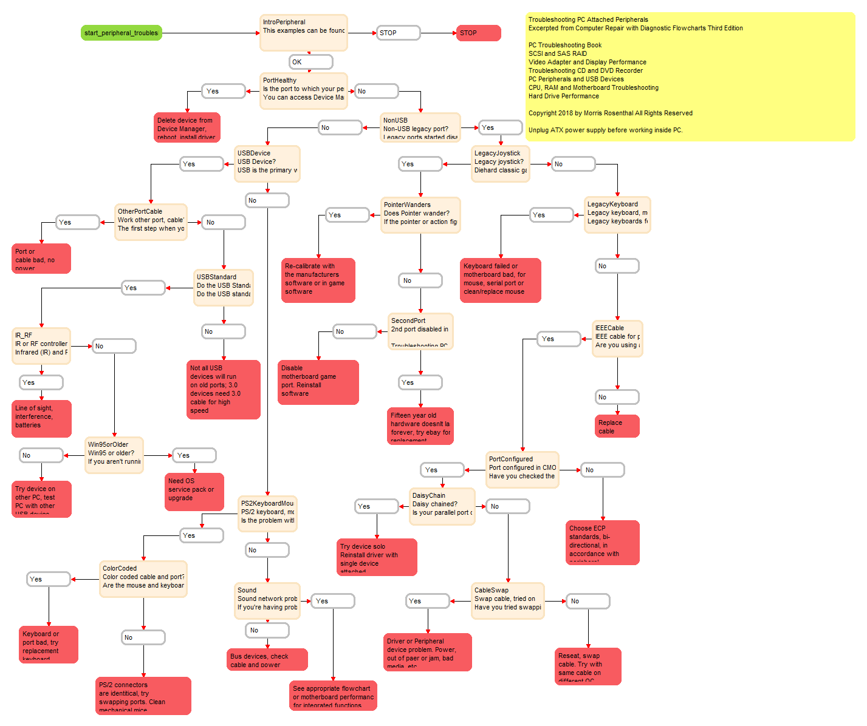
VisiRule Peripheral Troubleshooter

Slide 2
Areas Covered
Simple FlowChart Diagram
Converted manually into VisiRule chart
Upload VisiRule chart to server
Publish and run chart on server split pane
Compile into JS and run client side

Slide 3
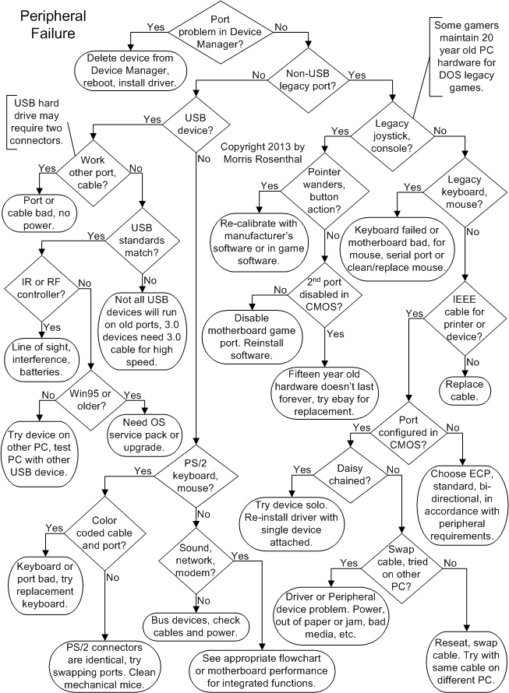
We start with an: Original Flowchart
https://www.ifitjams.com/attached.htm
Troubleshooting PC Attached Peripherals
Excerpted from Computer Repair with Diagnostic Flowcharts Third Edition
Notes:
Original Flowchart

Slide 4
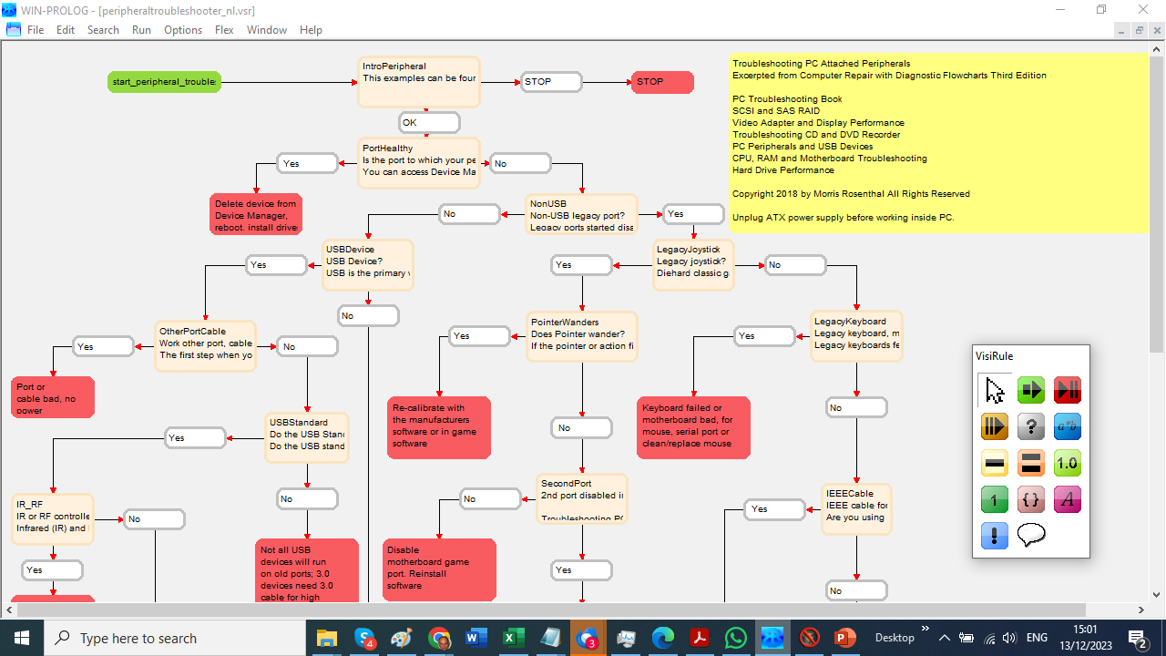
VisiRule FlowChart
Notes:
FlowChart represented in VisiRule

Slide 5
Exported PNG of VisiRule FlowChart
Notes:
We can export the chart as a PNG

Slide 6
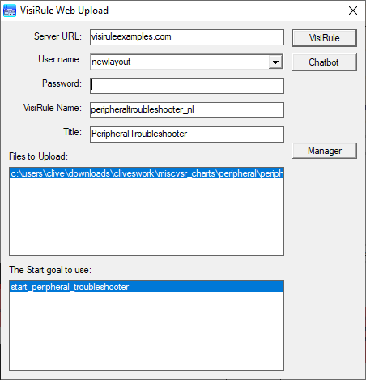
VisiRule Uploader for Web Server delivery
Notes:
VisiRule provides an uploader

Slide 7
Notes:
When uploaded the chart is presented as a sequence of questions

Slide 8
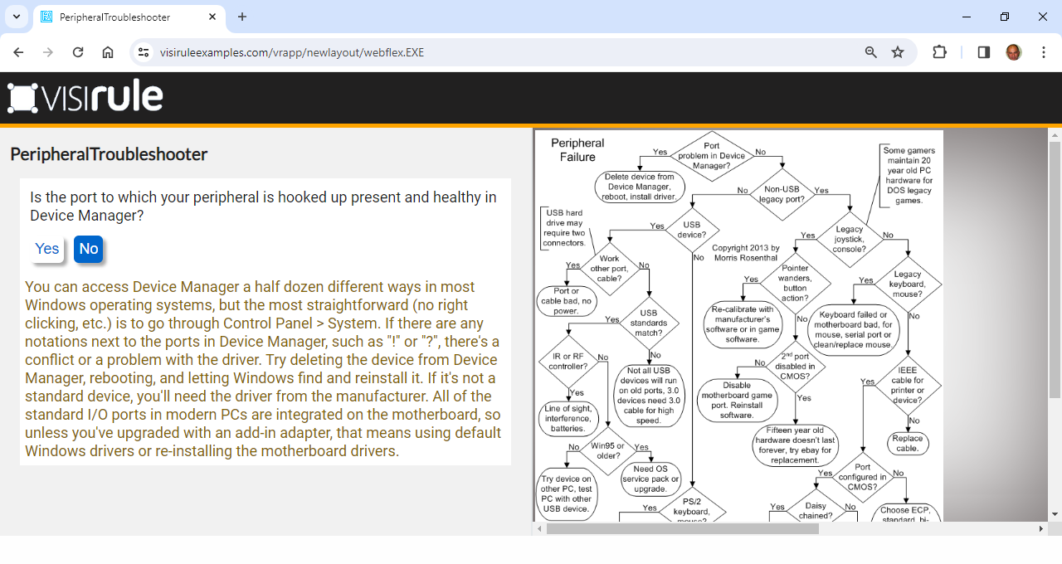
Notes:
Each answer leads to another question

Slide 9
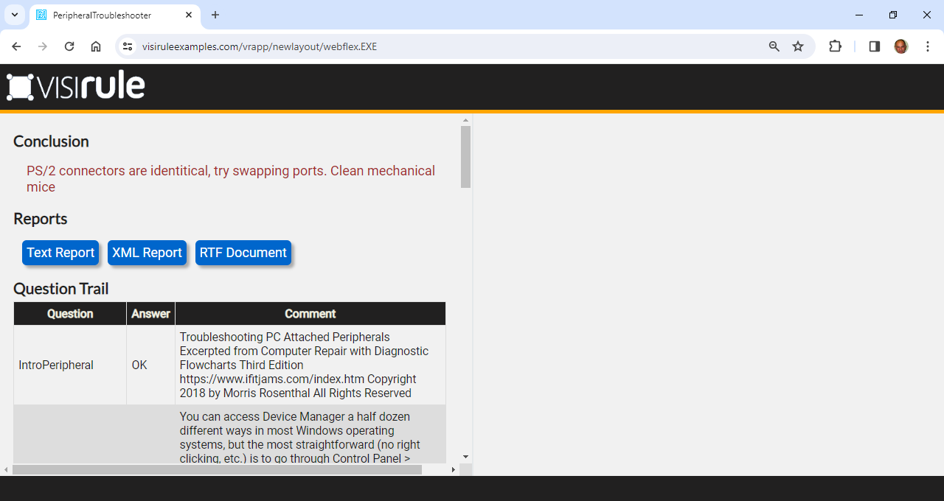
Notes:
A conclusion is reached when the tree is completed.

Slide 10
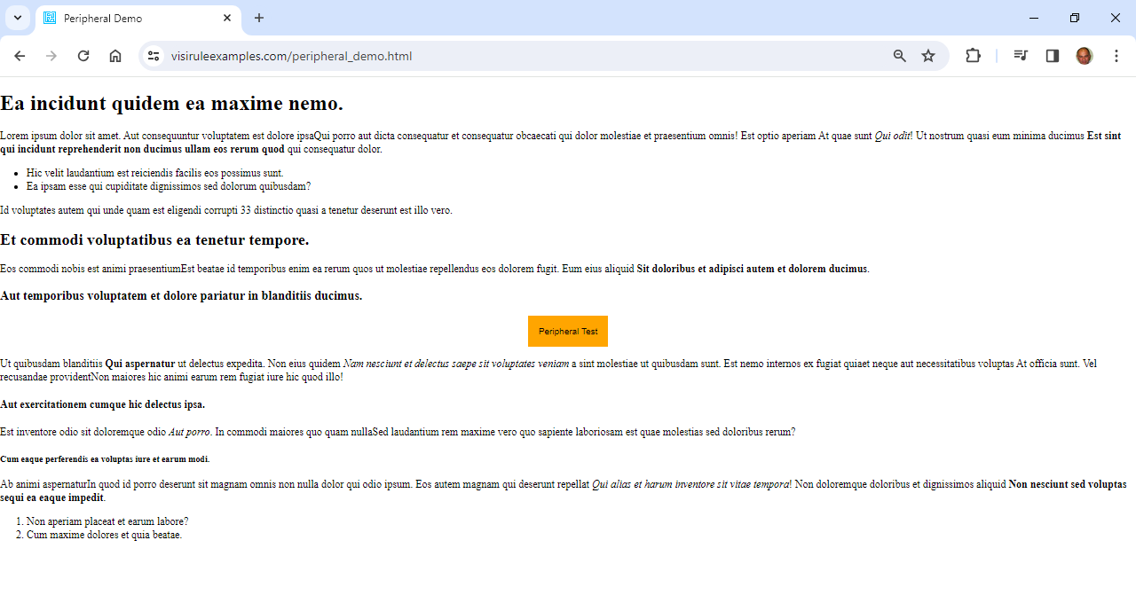
Notes:
We can also deliver the same chart to run client side: https://visiruleexamples.com/peripheral_demo.html

Slide 11
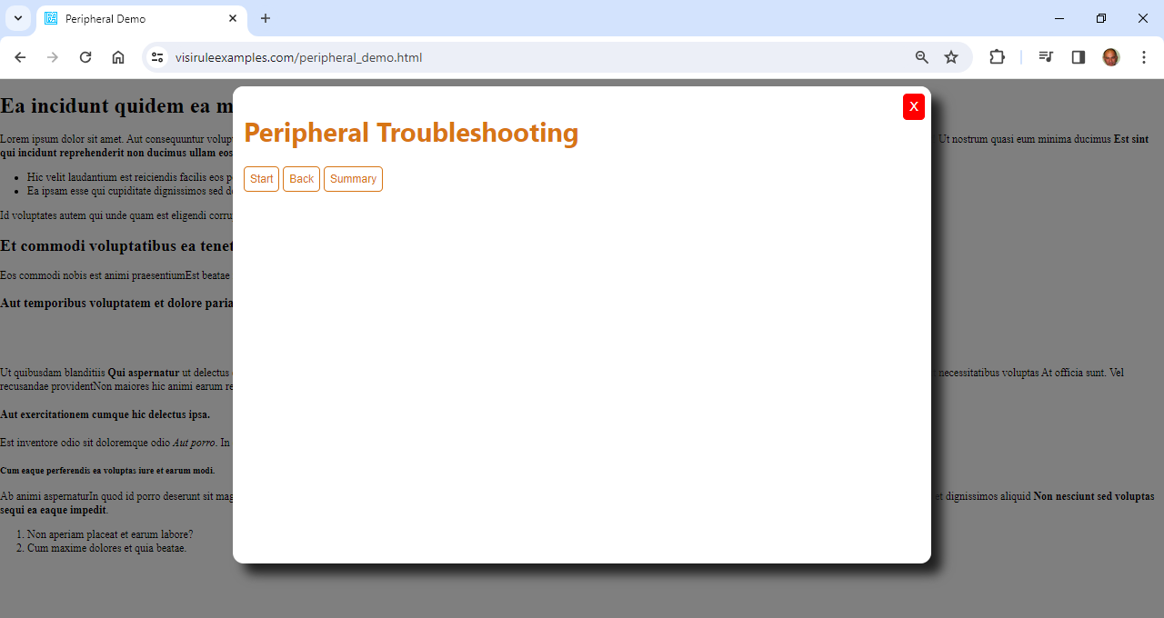

Slide 12
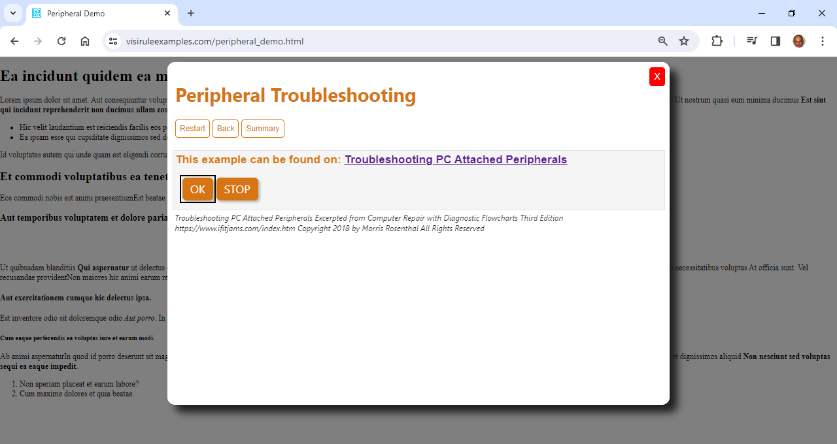

Slide 13
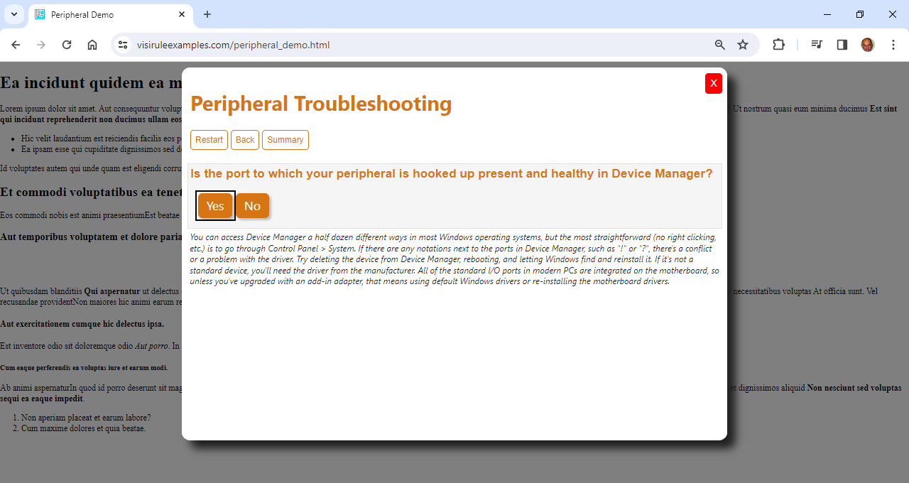

Slide 14
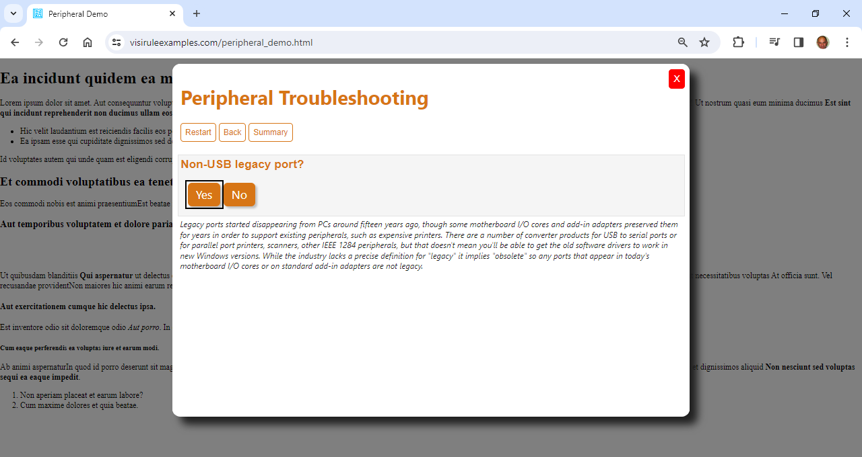

Slide 15
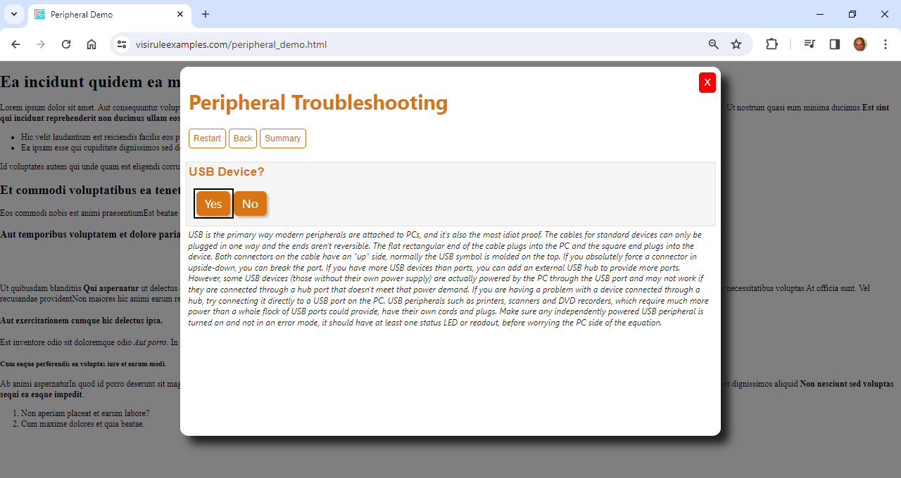

Slide 16
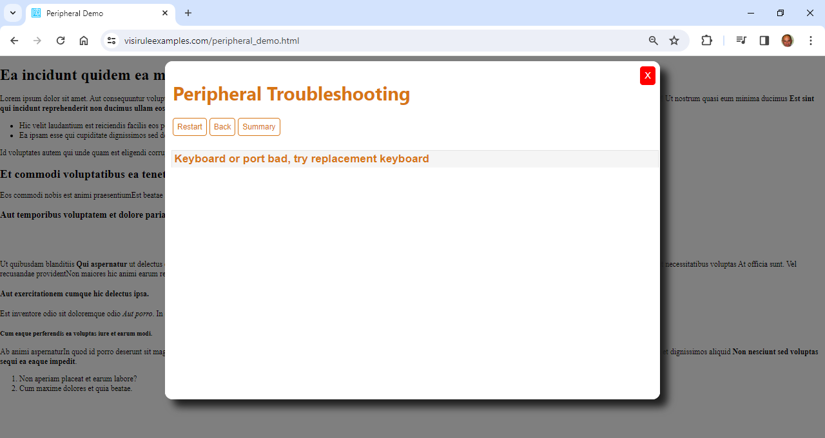

Slide 17
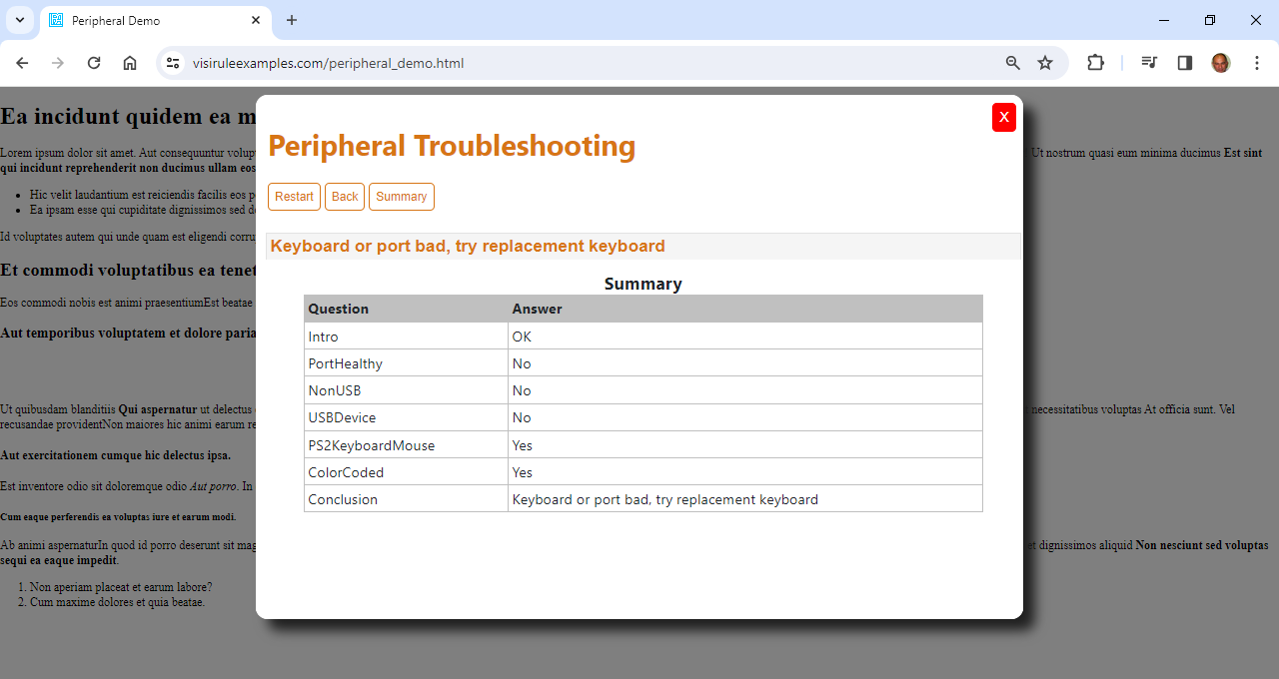

Slide 18
URLs
Original FlowChart Diagram: https://www.ifitjams.com/attached.htm
Converted manually into VisiRule chart
Upload VisiRule chart to server
Publish and run chart on server using split pane: https://visiruleexamples.com/vrapp/newlayout/peripheraltroubleshooter_nl
Compile into JS and run client side in fixed popup panel: https://visiruleexamples.com/peripheral_demo.html

