Slide 1
Adding Picture to Charts

Slide 2
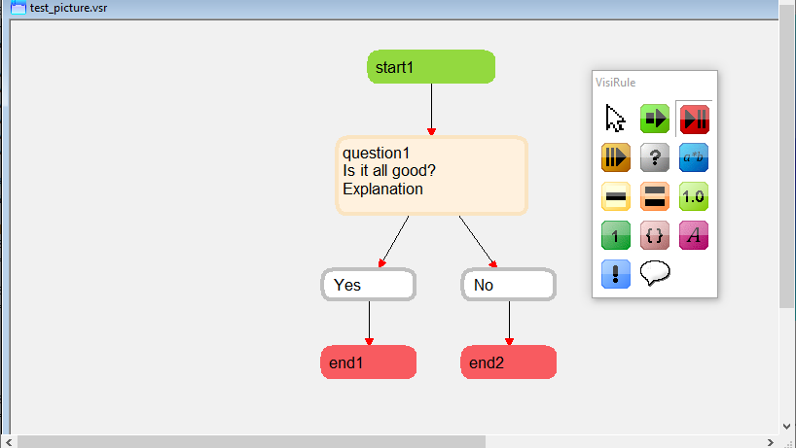
Notes:
Simple chart with one question

Slide 3
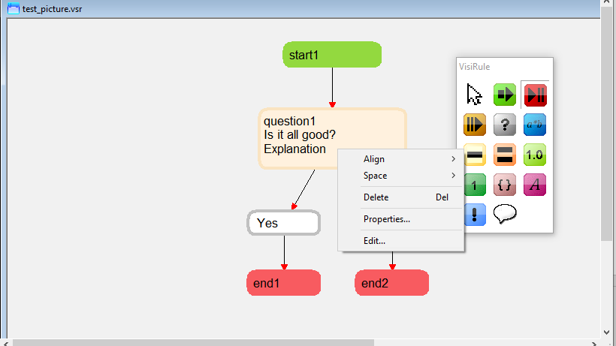
Notes:
Right click to edit question

Slide 4
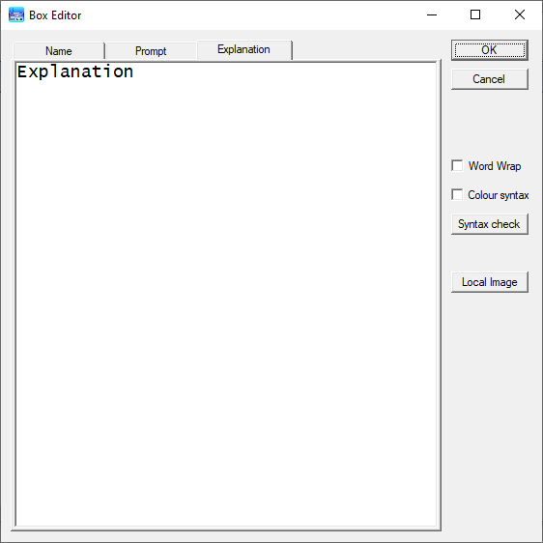
Notes:
Tab to third tab (explanation)

Slide 5
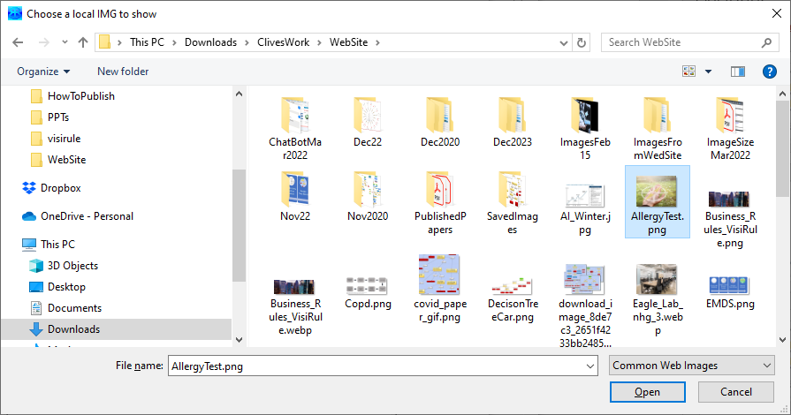
Notes:
Select local image and choose picture

Slide 6
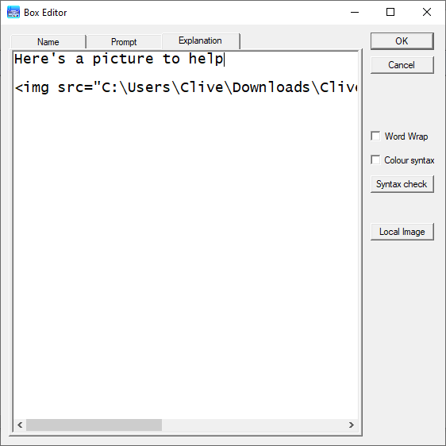
Notes:
This adds the HTML for the picture

Slide 7
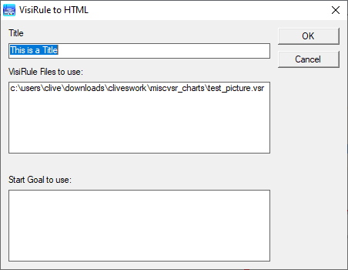
Notes:
Save file and regenerate HTML

Slide 8
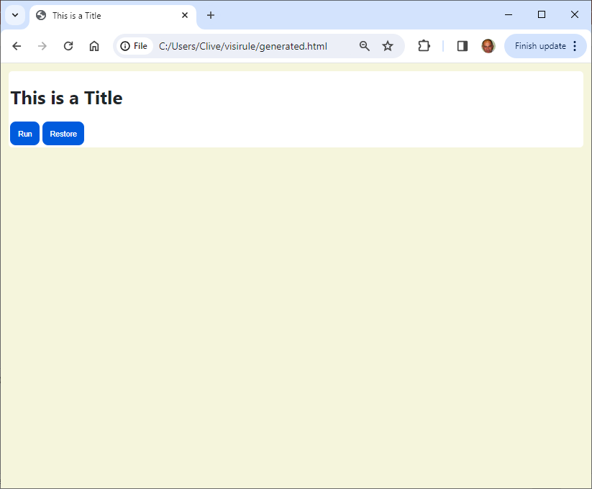
Notes:
Open the generated HTML in the browser

Slide 9
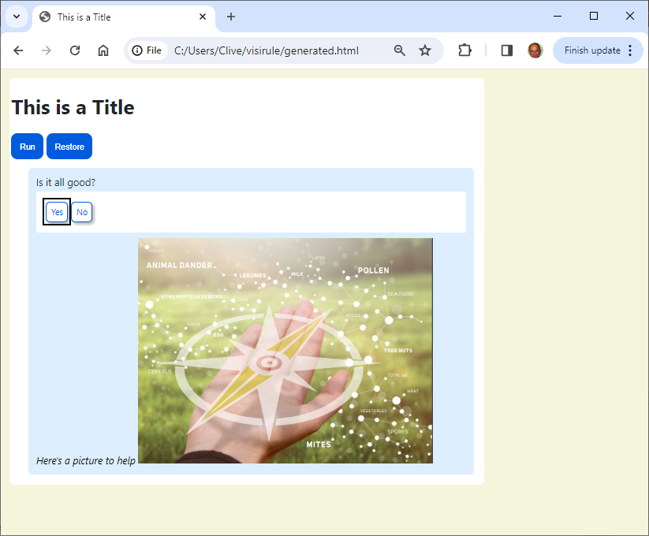
Notes:
Picture appears as part of the explanation

Slide 10
Easy to add images, videos into questions (and display statements) Any valid HTML can be incorporated Code generator recognizes HTML and passes it into generated code

